Slide 1
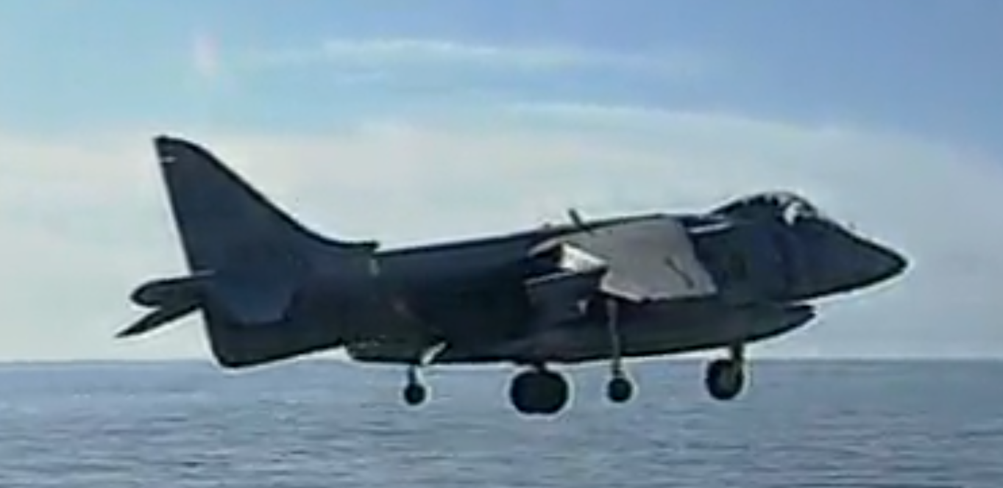
[3]
Modeling and Simulating a Vectored Thrust Aircraft
By Tyler Freitas
ME547 student
University of Washington
Seattle, WA, USA
tfreita@uw.edu
Harrier Jump Jet Video [3]
https://video-alexanderstreet-com.offcampus.lib.washington.edu/watch/the-harrier-jump-jet/clips/181690
Notes:
note: Copy Link to Browser

Slide 2
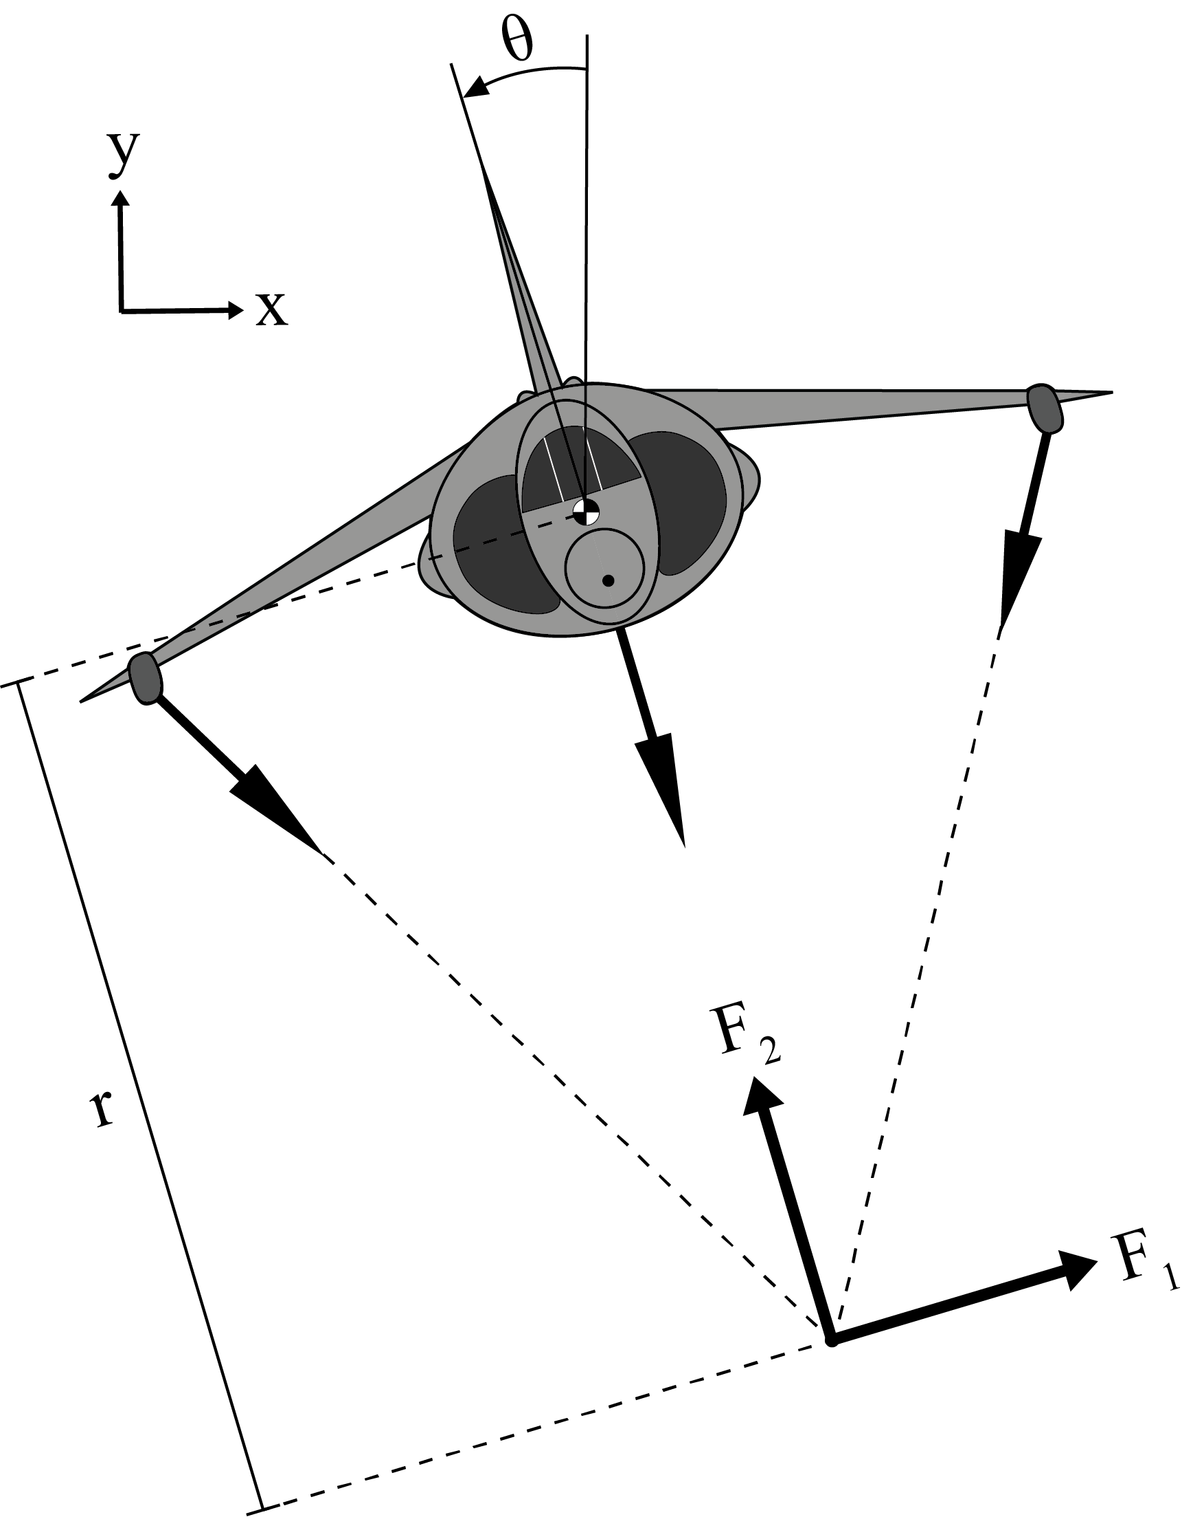
Problem Formulation: Model
Plant:
Vectored Thrust Aircraft (2D Rigid Body) with 3 thrusters
Input:
Reaction forces (F₁, F₂) of the thrusters on the aircraft
Output:
Aircraft’s Position (X, Y) and Orientation (θ)
Note:
Reaction forces of thrusters are translated to a common intersection point
r is the distance from the aircraft centroid to the thrusters' intersection.
2D Plant Free-Body Diagram
Note: not to scale

Slide 3
Problem Formulation: Physics
Aerodynamic Forces: (Newton’s 2nd Law, F = ma)
Lift/Thrust – Thruster Reactions on Aircraft (Newton’s 3rd Law)
Weight – Aircraft Mass
Drag – Air Resistance & Thruster Reactions on Aircraft in Drag direction
Assumptions:
No Air Torque Resistance
Small Angle Approximation
Hovering Aircraft
Same Angles Changes of the Wingtip Thrusters

Slide 4
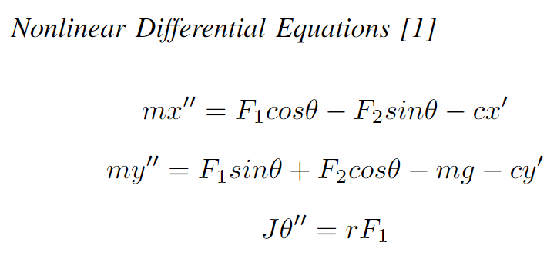
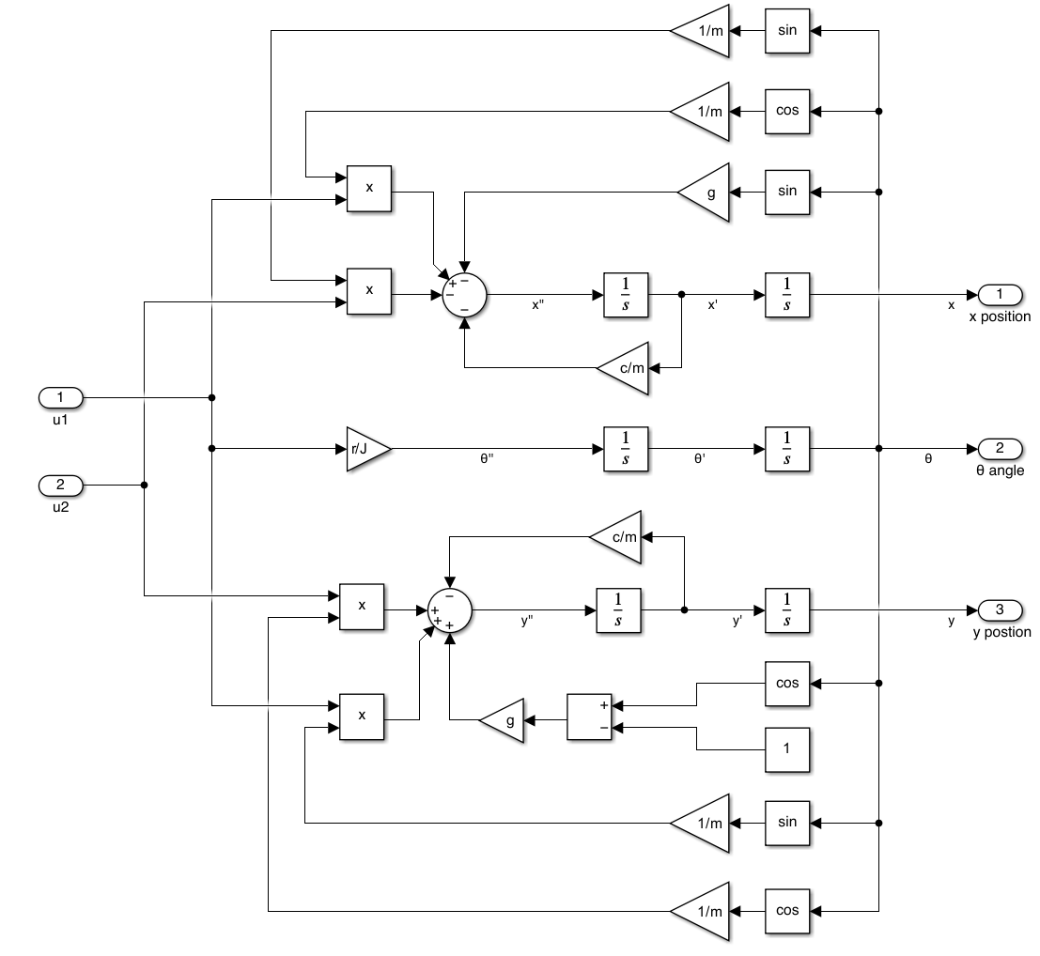
Problem Formulation: Physics Cont’d
Mathematical Variables:
F₁ - aircraft horizontal reaction
F₂ - aircraft vertical reaction
J - moment of inertia
c - damping coefficient
g - acceleration due to gravity
m - aircraft mass
x - aircraft horizontal position
x′ - aircraft horizontal velocity
x′′ - aircraft horizontal acceleration
y - aircraft vertical position
y′ - aircraft vertical velocity
y′′- aircraft vertical acceleration
θ - aircraft angular position
θ′′ - aircraft angular acceleration
r - distance from aircraft centroid to thrusters' intersection
[1]
Nonlinear Block Diagram

Slide 5
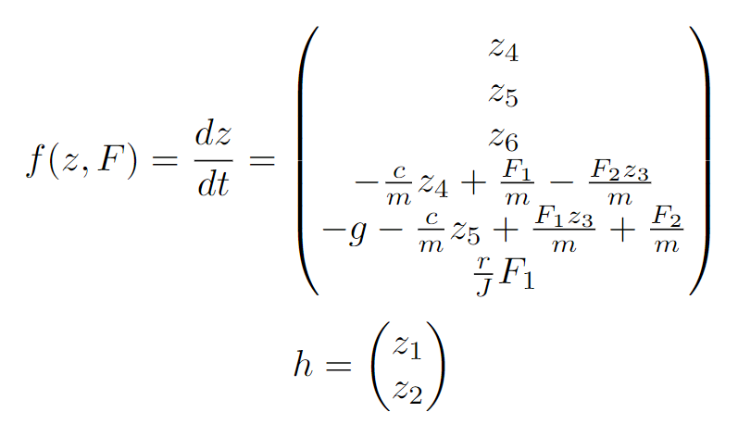
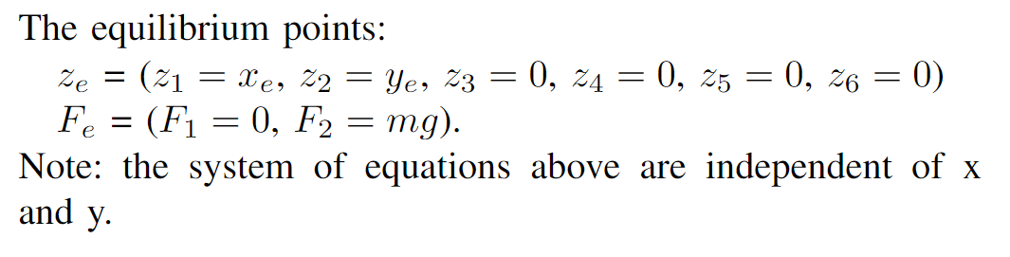
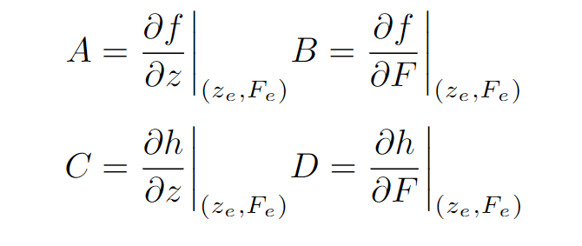
Analysis: Nonlinear State Space Model
More Analysis Variables:
y_{e} - y equilibrium point
x_{e} - x equilibrium point
z_{e} - state-space equilibrium points
F_{e} - input equilibrium points
A, B, C, D - state-space matrices
ζ - linearized state-space variable
v - linearized state-space input
P - linearized state-space output
z - nonlinear state-space variable
f - time derivative of z
h - nonlinear state-space output
F - nonlinear state-space input
[1]

Slide 6
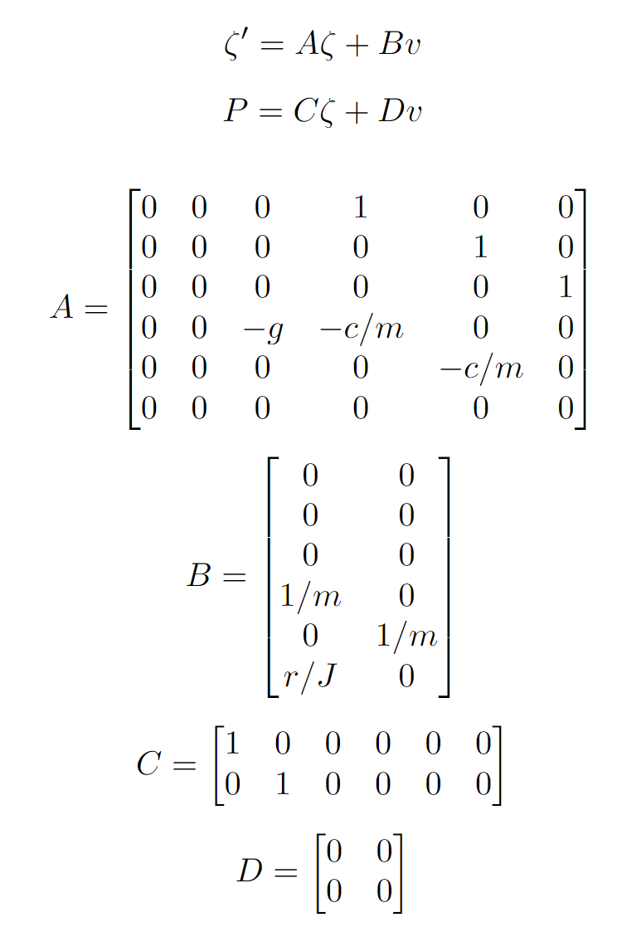
Analysis: Jacobian Linearization [1],[2]
Jacobian Matrices [1]
Nonlinear State-Space System & Equilibrium Points [1]
Linearized State-Space System [1]

Slide 7
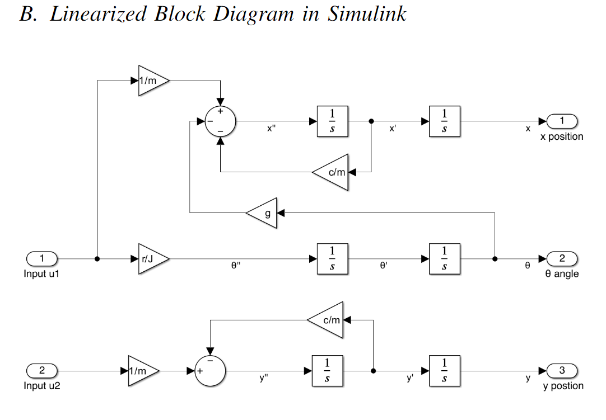
Analysis: Linearized System Forms
Linearized Block Diagram
Linearized State-Space System [1]

Slide 8
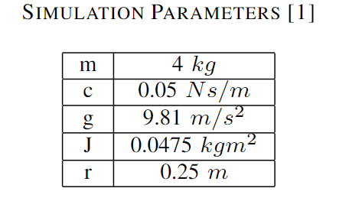
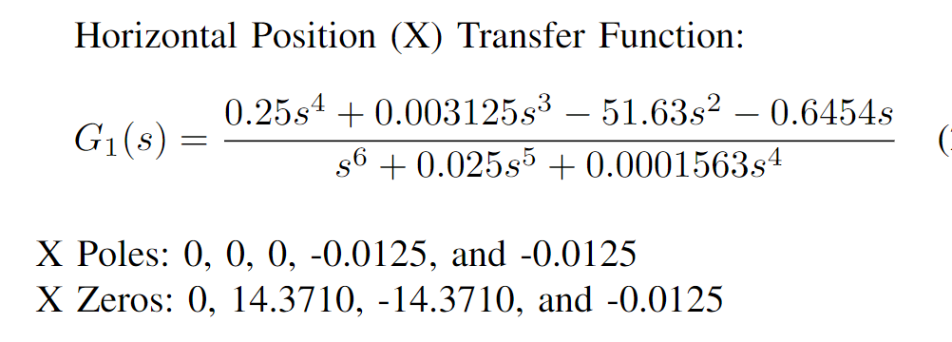
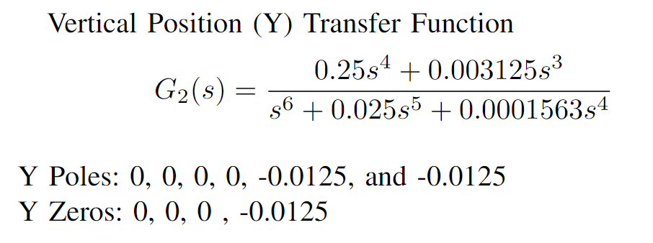
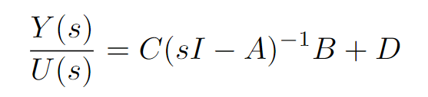
Simulation: Parameters & Transfer functions
Simulation System Parameters
Linearized Transfer Function with Poles & Zeros
[1]
State-Space System to Transfer Function
Note: No Initial conditions

Slide 9
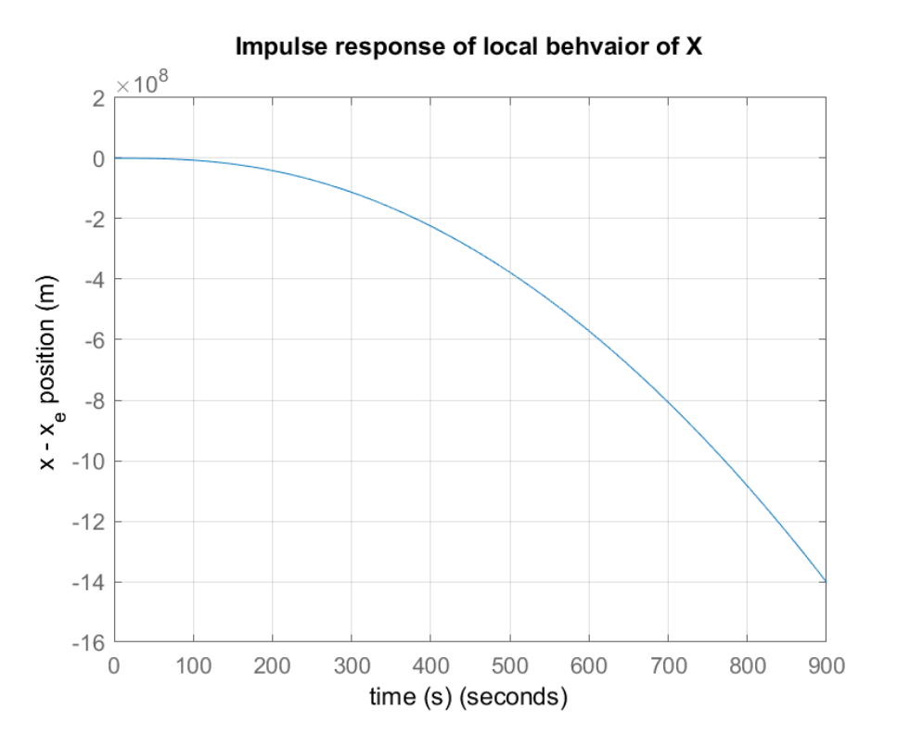
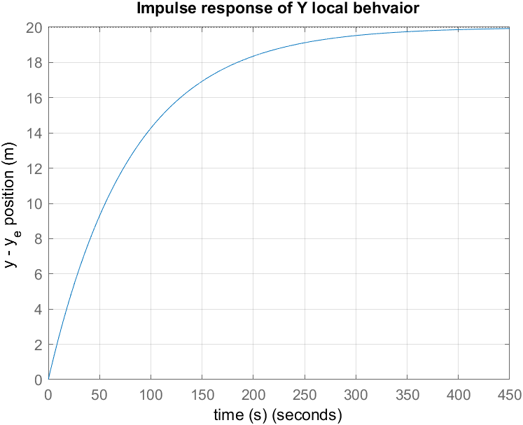
Results: Impulse Response

Slide 10
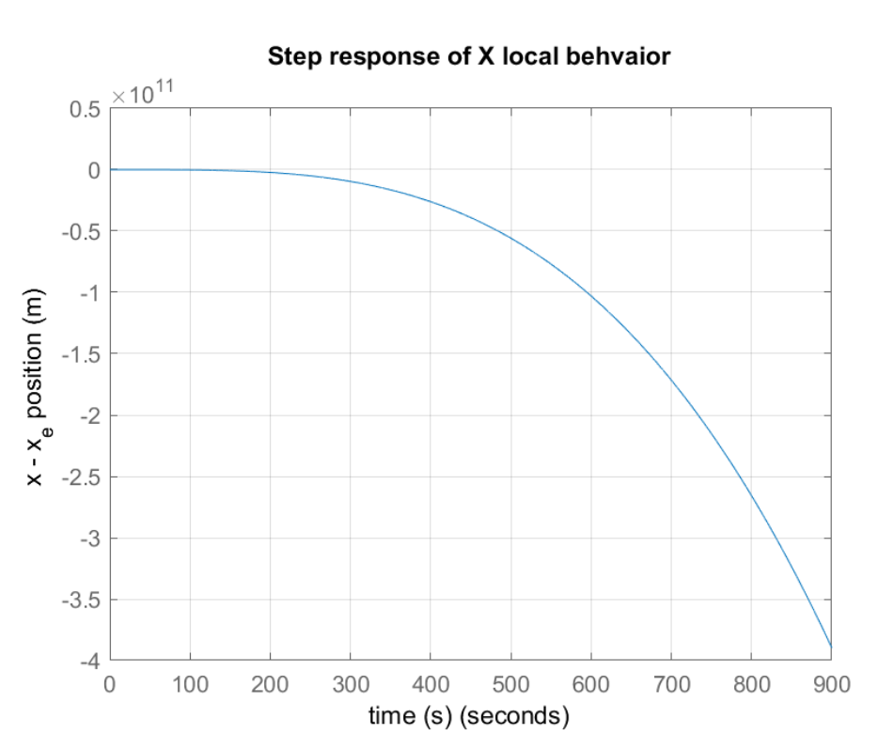
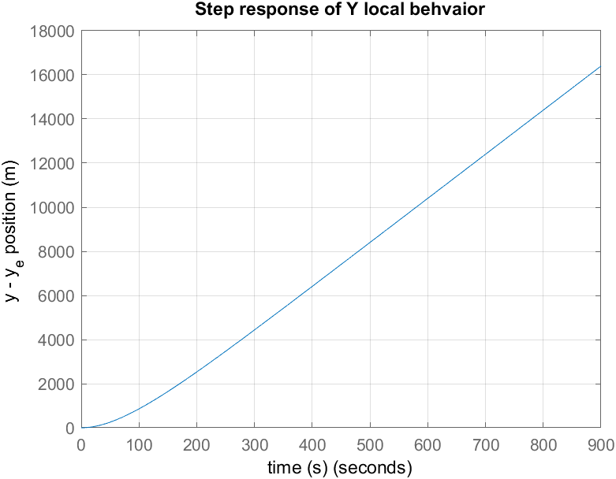
Results: Step Response

Slide 11
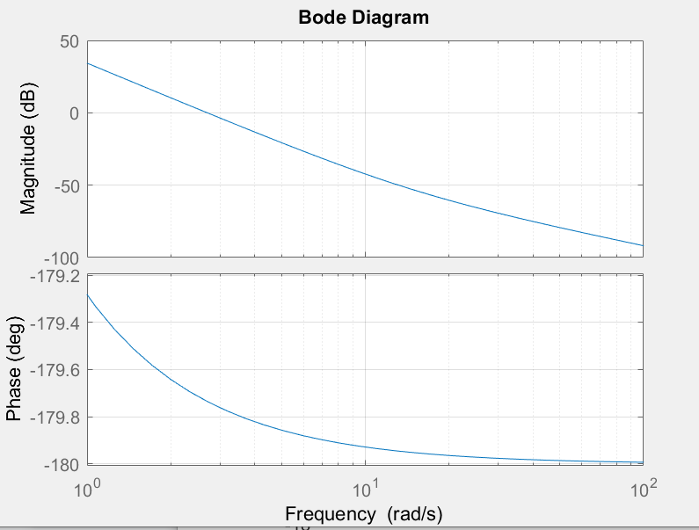
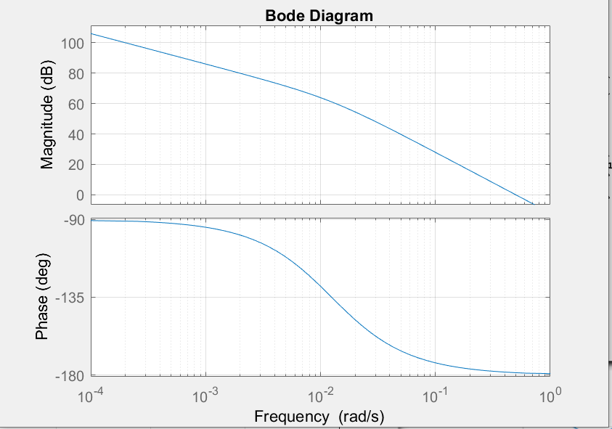
Results: Bode Plots
Local X
Local Y

Slide 12
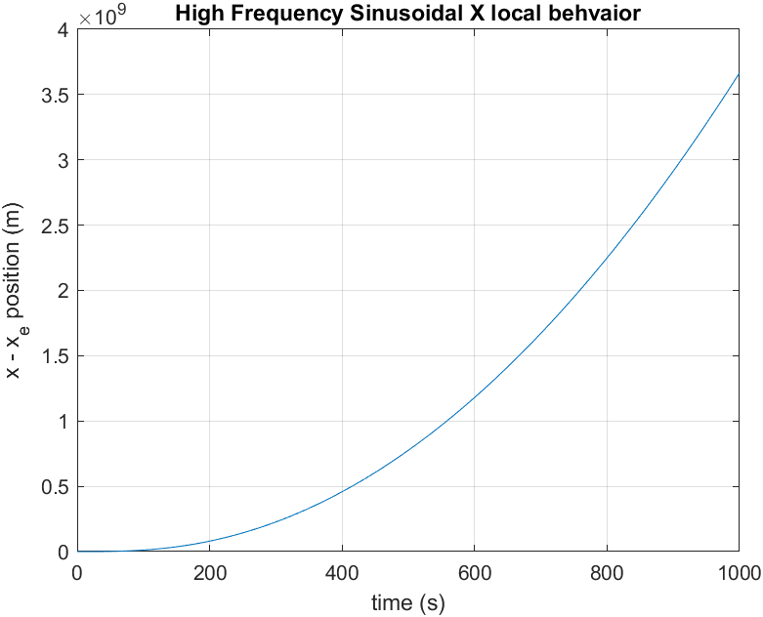
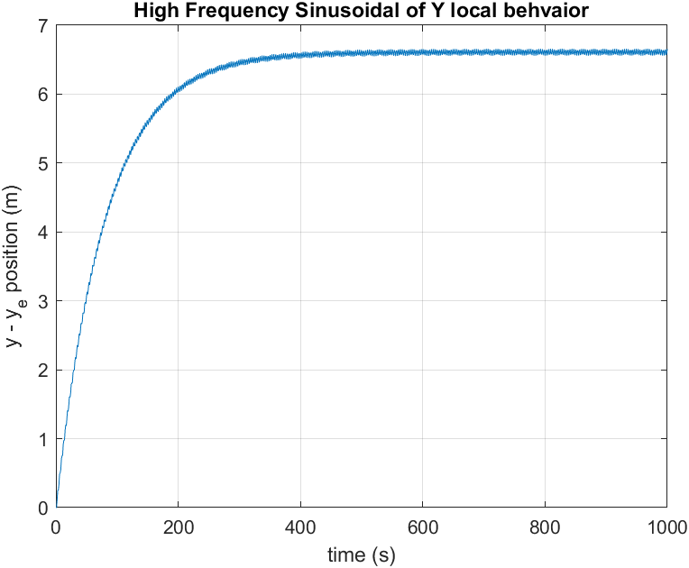
Results: High Frequency Sinusoidal

Slide 13
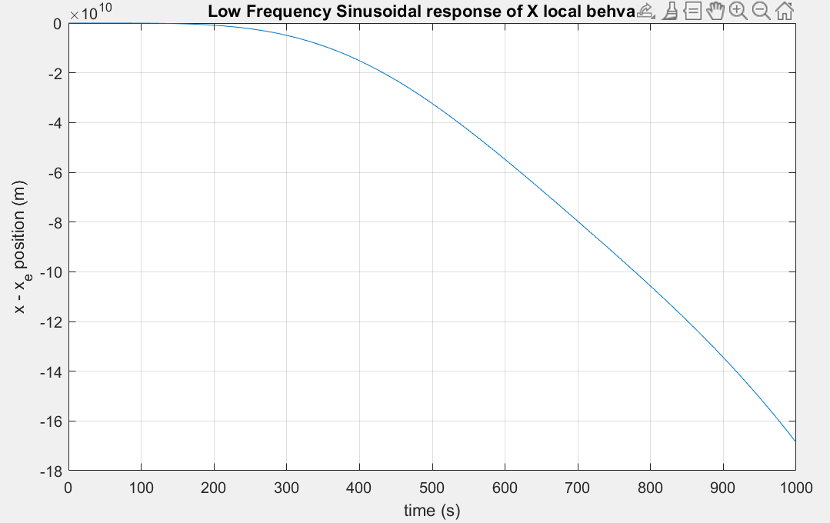
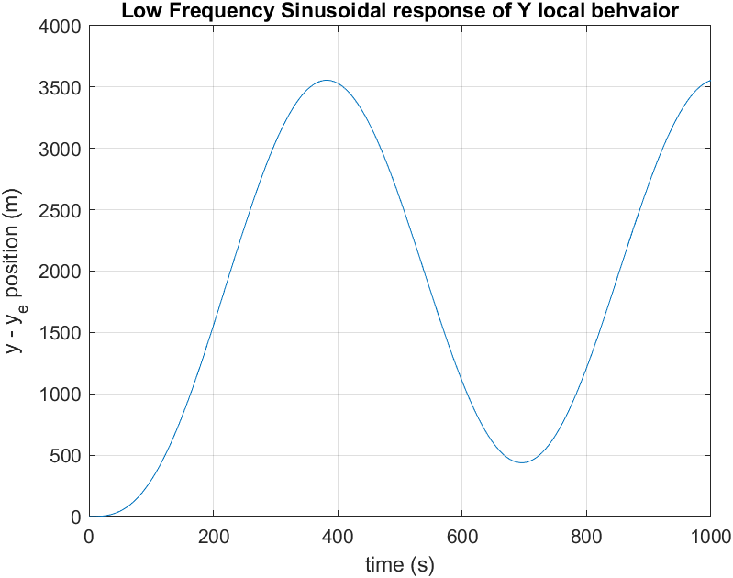
Results: Low Frequency Sinusoidal

Slide 14
Limitations & Future Improvements
Model Limitations:
Neglected Air Torque Resistance
Small Angle Approximation Limitations
Future Improvements:
Linear-Quadratic Regulator (LQR) controller to control external disturbances and stability
Simulating Vertical Takeoff and Landing Maneuvers

Slide 15
Rferences
[1] K. J. Åström, R. M. Murray, \textit{Feedback Systems: An Introduction for Scientists and Engineers.} Princeton University Press, 2008. [Online]. Available: http://www.cds.caltech.edu/$\sim$murray/books/AM08/pdf/fbs-public\_24Jul2020.pdf. Accessed: Feb. 10, 2024.
[2] A. D. Lewis and D. R. Tyner, “Geometric Jacobian linearization and LQR theory,” Journal of Geometric Mechanics, vol. 2, no. 4, pp. 397–440, 2010, Accessed on: Feb. 10, 2024. [Online]. Available: https://doi.org/10.3934/jgm.2010.2.397.
[3] D. Sharam, W. Gibbs, World Wide Entertainment, The Harrier Jump Jet. (2006). Accessed: Feb. 18, 2024. [Online Video]. Available: https://video.alexanderstreet.com/watch/the-harrier-jump-jet.

